Slide 1

Data Structures Using C++ 2E
Chapter 7
Stacks

Slide 2
Objectives
Learn about stacks
Examine various stack operations
Learn how to implement a stack as an array
Learn how to implement a stack as a linked list
Discover stack applications
Learn how to use a stack to remove recursion
Data Structures Using C++ 2E

Slide 3
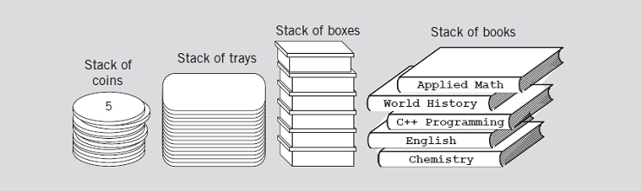
Stacks
Data structure
  Elements added, removed from one end only
  Last In First Out (LIFO)
FIGURE 7-1 Various examples of stacks
Data Structures Using C++ 2E

Slide 4
Stacks (cont’d.)
push operation
  Add element onto the stack
top operation
  Retrieve top element of the stack, w/o remove top element
pop operation
  Remove top element from the stack
Data Structures Using C++ 2E

Slide 5

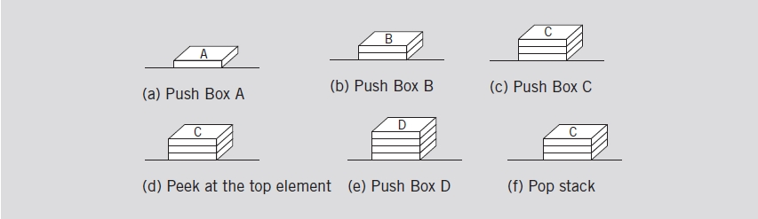
Stacks (cont’d.)
FIGURE 7-2 Empty stack
FIGURE 7-3 Stack operations
Data Structures Using C++ 2E

Slide 6
Stacks (cont’d.)
Stack element removal
  Occurs only if something is in the stack
Stack element added only if room available
isFullStack operation
  Checks for full stack
isEmptyStack operation
  Checks for empty stack
initializeStack operation
  Initializes stack to an empty state
Data Structures Using C++ 2E

Slide 7
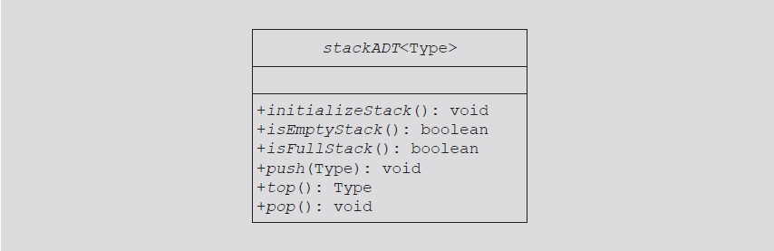
Stacks (cont’d.)
Review code on page 398
  Illustrates class specifying basic stack operations
FIGURE 7-4 UML class diagram of the class stackADT
Data Structures Using C++ 2E

Slide 8
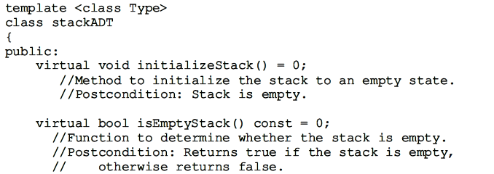
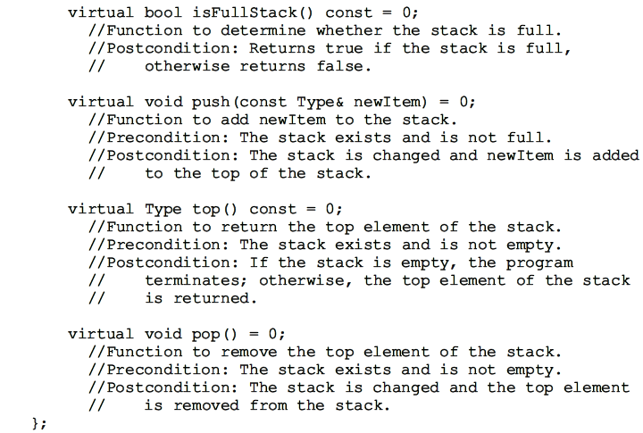
Data Structures Using C++ 2E

Slide 9
Implementation of Stacks as Arrays
(fixed size) array is allocated by constructor
First stack element
  Put in first array slot
Second stack element
  Put in second array slot, and so on
Top of stack
  Index of last element added to stack
Stack element accessed only through the top
  Problem: array is a random access data structure
  Solution: use another variable (stackTop)
    Keeps track of the top position of the array
Data Structures Using C++ 2E

Slide 10
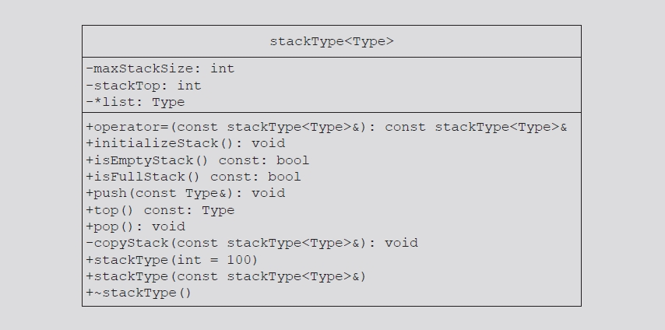
Implementation of Stacks as Arrays (cont’d.)
Review code on page 400
  Illustrates basic operations on a stack as an array
FIGURE 7-5 UML class diagram of the class stackType
Data Structures Using C++ 2E

Slide 11
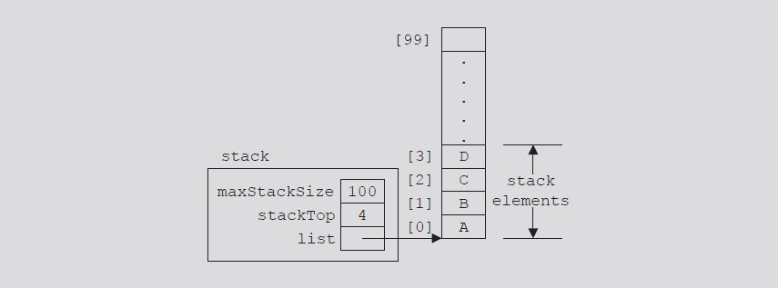
Implementation of Stacks as Arrays (cont’d.)
If stackTop = 0, stack is empty
If stackTop > 0, top element at index stackTop - 1
FIGURE 7-6 Example of a stack
Data Structures Using C++ 2E

Slide 12
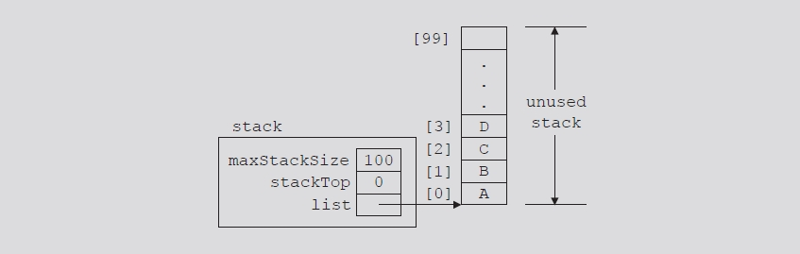
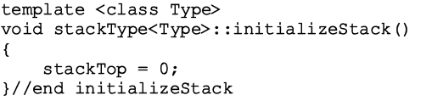
Initialize Stack
Value of stackTop if stack empty
  Set stackTop to zero to initialize the stack
Definition of function initializeStack
FIGURE 7-7 Empty stack
Data Structures Using C++ 2E

Slide 13
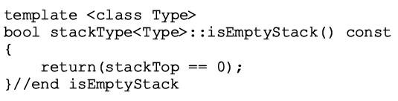
Empty Stack
Value of stackTop indicates if stack empty
  If stackTop = zero: stack empty
  Otherwise: stack not empty
Definition of function isEmptyStack
Data Structures Using C++ 2E

Slide 14
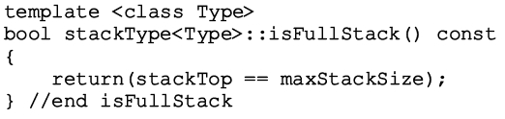
Full Stack
Stack full
  If stackTop is equal to maxStackSize
Definition of function isFullStack
Data Structures Using C++ 2E

Slide 15
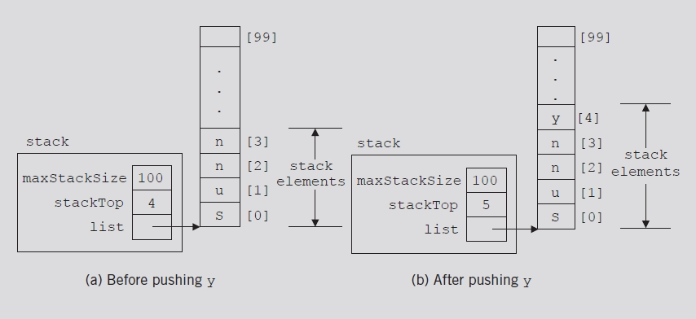
Push
Two-step process
  Store newItem in array component indicated by stackTop
  Increment stackTop
FIGURE 7-8 Stack before and after the push operation
Data Structures Using C++ 2E

Slide 16
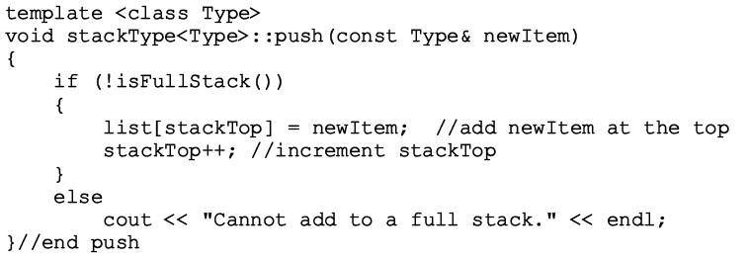
Push (cont’d.)
Definition of push operation
Data Structures Using C++ 2E

Slide 17
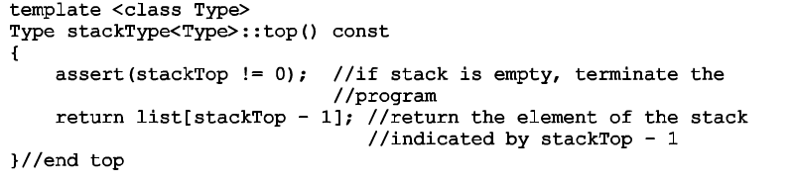
Return the Top Element
Definition of top operation
Data Structures Using C++ 2E

Slide 18
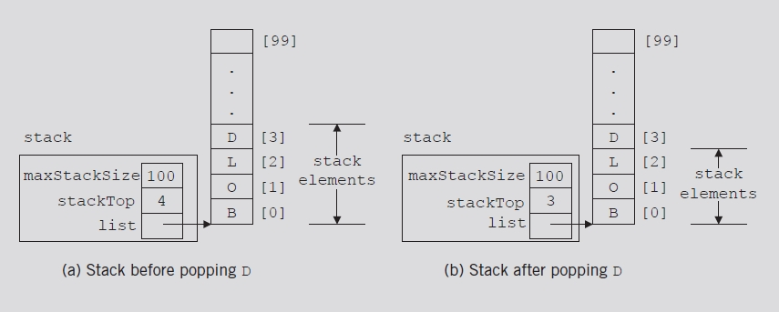
Pop
Remove (pop) element from stack
  Decrement stackTop by one
FIGURE 7-9 Stack before and after the pop operation
Data Structures Using C++ 2E

Slide 19
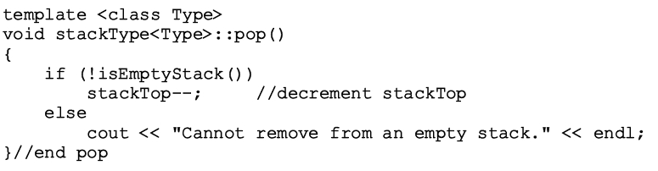
Pop (cont’d.)
Definition of pop operation
Underflow
  Removing an item from an empty stack
    Check within pop operation (see below)
    Check before calling function pop
Need “delete” the popped element?
Data Structures Using C++ 2E
Notes:
If <Type> is an elementary data type (int. float, etc), no need to delete it.
If <Type> is say a structure/class, do need to delete it.
“Template specialization” is the way to do type checking. Other than that, no good way to tell whether Type is an elementary data type. Here we assume it is. Therefore no need to “delete” it.
***template specialization***
http://stackoverflow.com/questions/13636540/how-to-check-for-the-type-of-a-template-parameter
http://www.dreamincode.net/forums/topic/186639-how-to-determine-the-type-of-template-arguments/

Slide 20
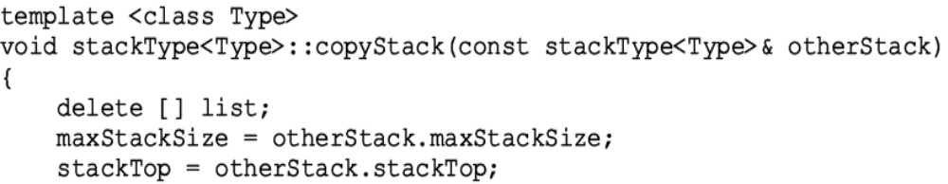
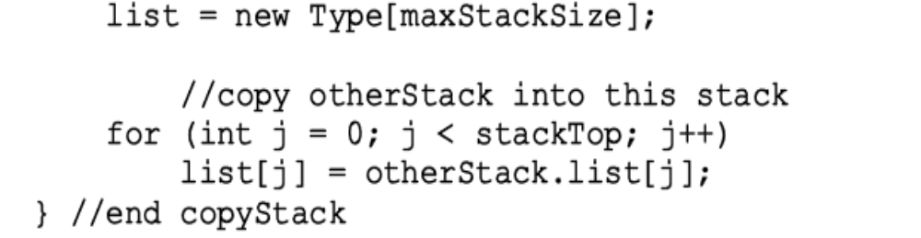
Copy Stack
Definition of function copyStack
O(n)
What if list is NULL?
Data Structures Using C++ 2E
Notes:
Delete a NULL pointer in copyStack? Deleting a NULL pointer is a no-op.
http://en.wikipedia.org/wiki/Delete_(C%2B%2B)

Slide 21
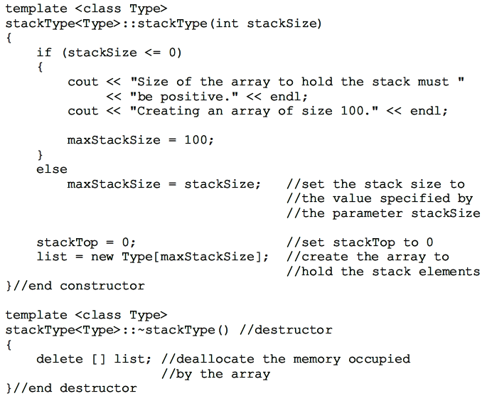
Constructor and Destructor
Data Structures Using C++ 2E

Slide 22
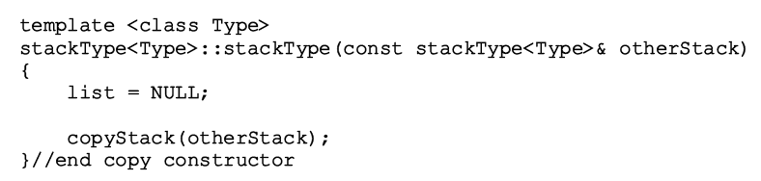
Copy Constructor
Definition of the copy constructor
O(n)
Data Structures Using C++ 2E

Slide 23
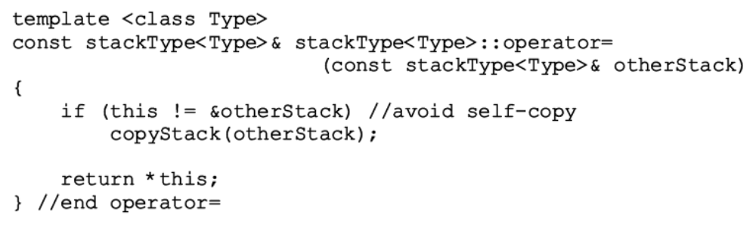
Overloading the Assignment Operator (=)
Classes with pointer member variables
  Assignment operator must be explicitly overloaded
    Why?
Function definition to overload assignment operator for class stackType
O(n)
Data Structures Using C++ 2E

Slide 24
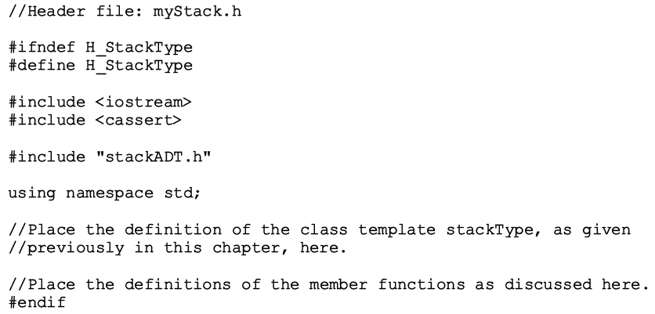
Stack Header File
myStack.h
  Header file name containing class stackType definition
Data Structures Using C++ 2E

Slide 25
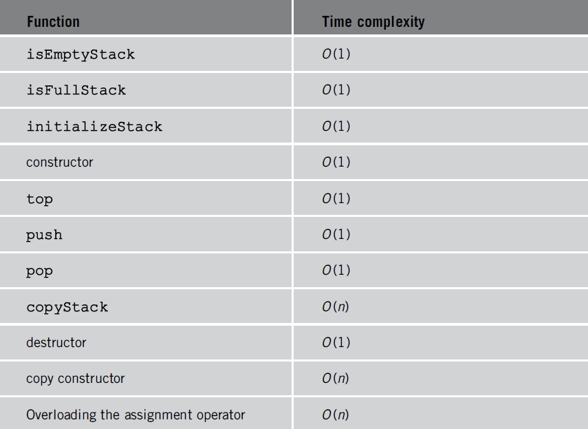
Stack Header File (cont’d.)
Stack operations analysis
  Similar to class arrayListType operations
TABLE 7-1 Time complexity of the operations of
the class stackType on a stack with n elements
Data Structures Using C++ 2E

Slide 26

Linked Implementation of Stacks
Disadvantage of array (linear) stack representation
  Fixed number of elements can be pushed onto stack
Solution
  Use pointer variables to dynamically allocate, deallocate memory
  Use linked list to dynamically organize data
Value of stackTop: array (linear) representation
  Indicates number of elements in the stack
    Gives index of the array
  Value of stackTop – 1
    Points to top item in the stack
Value of stackTop: linked representation
  Locates top element in the stack
    Gives address (memory location) of the top element of the stack
Data Structures Using C++ 2E

Slide 27
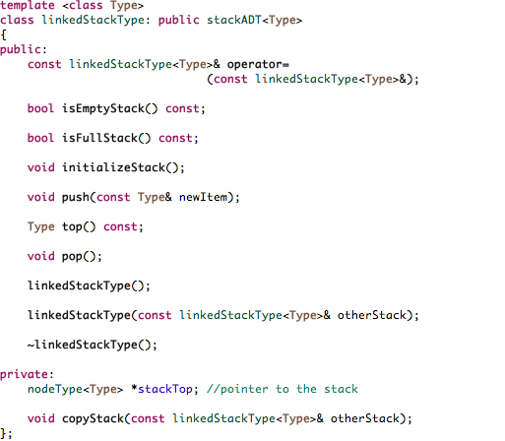
Data Structures Using C++ 2E

Slide 28
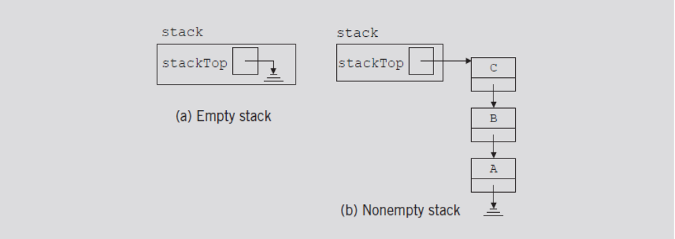
Linked Implementation of Stacks (cont’d.)
Example 7-2
  Stack: object of type linkedStackType
FIGURE 7-10 Empty and nonempty linked stacks
Data Structures Using C++ 2E

Slide 29
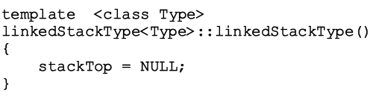
Default Constructor
When stack object declared
  Initializes stack to an empty state
  Sets stackTop to NULL
Definition of the default constructor
Data Structures Using C++ 2E

Slide 30
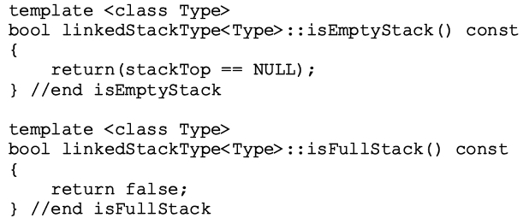
Empty Stack and Full Stack
Stack empty if stackTop is NULL
Stack never full
  Element memory allocated/deallocated dynamically
  Function isFullStack always returns false value
Data Structures Using C++ 2E

Slide 31
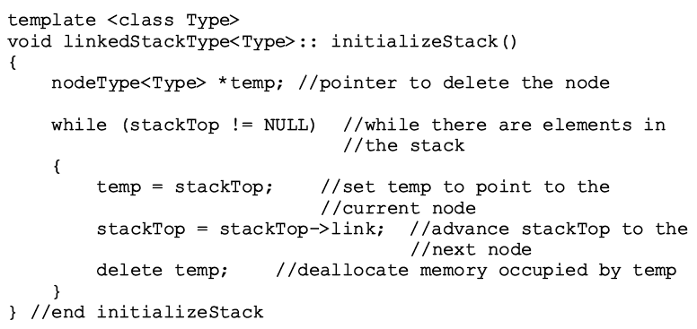
Initialize Stack
Reinitializes stack to an empty state
  deallocate memory occupied by the stack elements, set stackTop to NULL
Definition of the initializeStack function
O(n)
Data Structures Using C++ 2E

Slide 32

Push
newElement added at the beginning of the linked list pointed to by stackTop
Value of pointer stackTop updated
FIGURE 7-11 Stack before the push operation
Data Structures Using C++ 2E

Slide 33
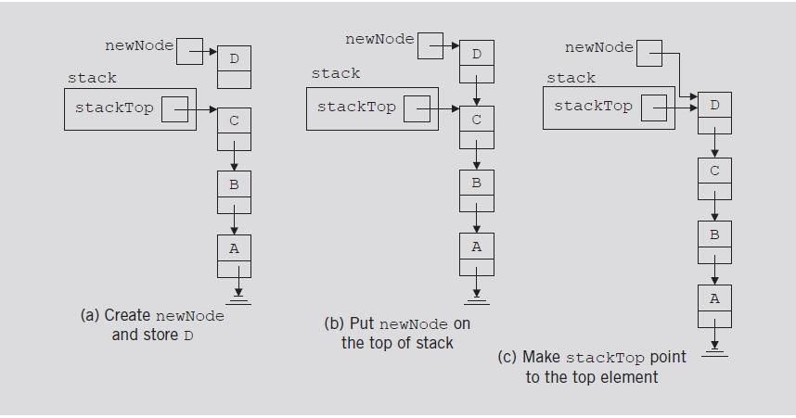
Push (cont’d.)
FIGURE 7-12 Push operation
Data Structures Using C++ 2E

Slide 34
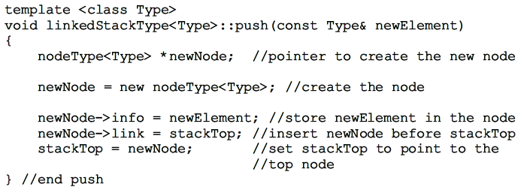
Push (cont’d.)
Definition of the push function
Data Structures Using C++ 2E

Slide 35
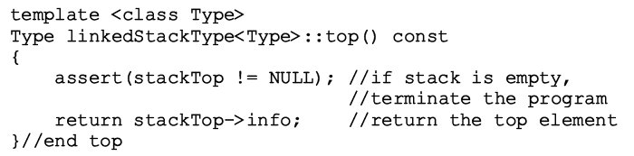
Return the Top Element
Returns information of the node to which stackTop pointing
Definition of the top function
Data Structures Using C++ 2E

Slide 36
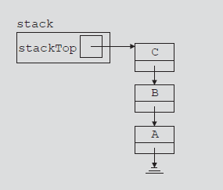
Pop
Removes top element of the stack
  Node pointed to by stackTop removed
  Value of pointer stackTop updated
Data Structures Using C++ 2E

Slide 37
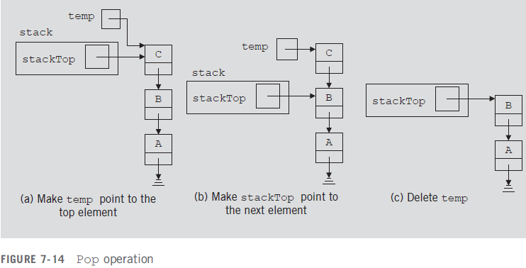
Pop (cont’d.)
Data Structures Using C++ 2E

Slide 38
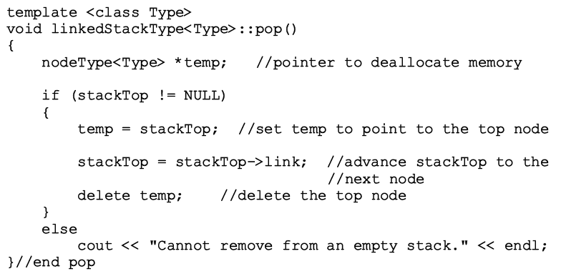
Pop (cont’d.)
Definition of the pop function
Data Structures Using C++ 2E

Slide 39
Copy Stack
Makes an identical copy of a stack
Definition similar to the definition of copyList for linked lists
Definition of the copyStack function
Data Structures Using C++ 2E

Slide 40
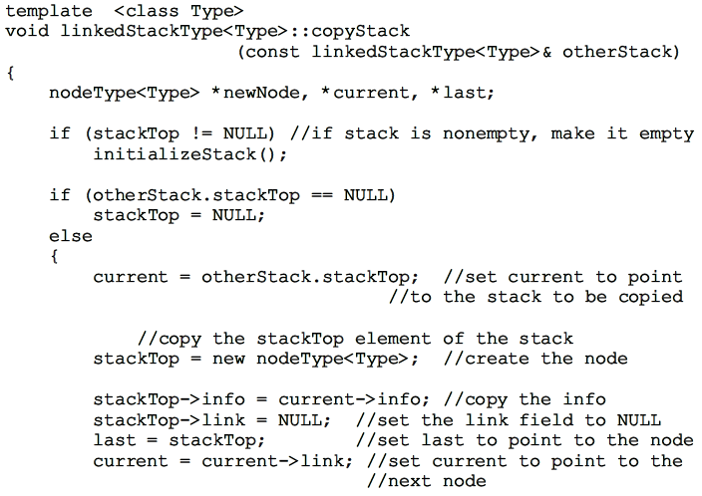
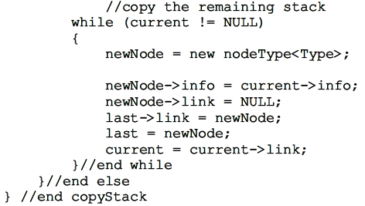
O(n)
Data Structures Using C++ 2E

Slide 41
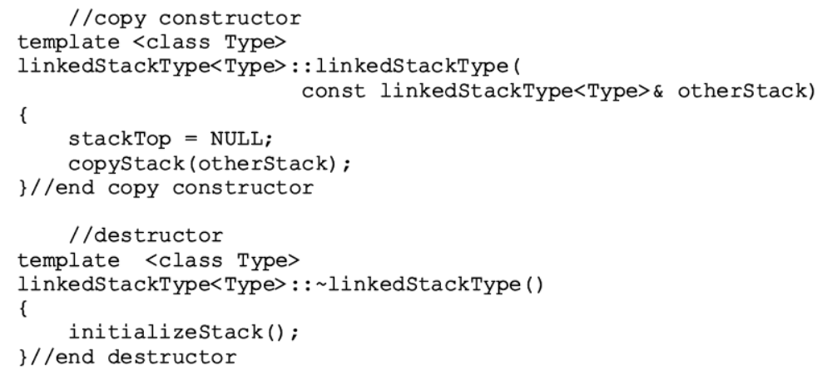
Constructors and Destructors
Definition of the functions to implement the copy constructor and the destructor
O(n)
O(n)
Data Structures Using C++ 2E

Slide 42
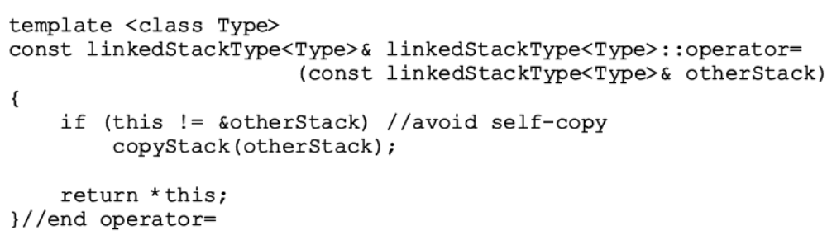
Overloading the Assignment Operator (=)
Definition of the functions to overload the assignment operator
O(n)
Data Structures Using C++ 2E

Slide 43

Overloading the Assignment Operator (=) (cont’d.)
TABLE 7-2 Time complexity of the operations of the class linkedStackType on a stack with n elements
Data Structures Using C++ 2E

Slide 44
Stack as Derived from the class unorderedLinkedList
Stack push function, list insertFirst function
  Similar algorithms
  initializeStack and initializeList, isEmptyList and isEmptyStack, etc.
class linkedStackType can be derived from class linkedListType
  class linkedListType: abstract class
class linkedStackType can be derived from class unorderedLinkedListType
  class unorderedLinkedListType: derived from class linkedListType
Data Structures Using C++ 2E

Slide 45
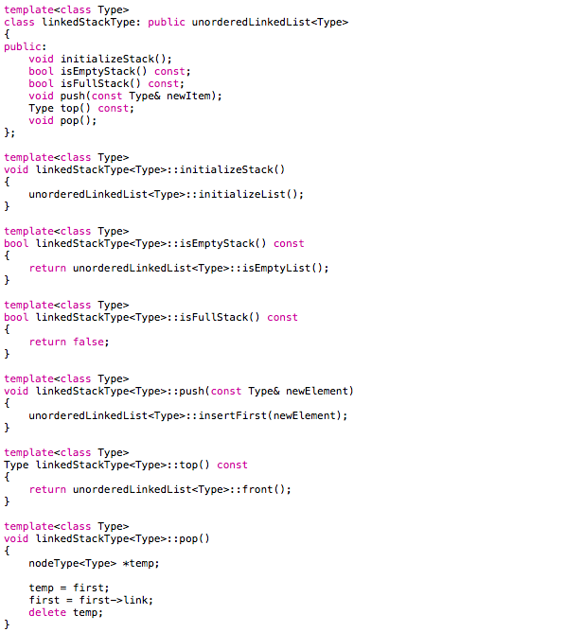
Data Structures Using C++ 2E

Slide 46
Application of Stacks: Postfix Expressions Calculator
Arithmetic notations
  Infix notation: operator between operands
  Prefix (Polish) notation: operator precedes operands
  Postfix (Reverse Polish) notation: operator follows operands
Stack use in compliers
  Translate infix expressions into some form of postfix notation
  Translate postfix expression into machine code
Data Structures Using C++ 2E

Slide 47
Infix, Prefix, and Postfix
Infix | Prefix | Postfix
A + B | + A B | A B +
A * B + C | + * A B C | A B * C +
A * (B + C) | * A + B C | A B C + *
A - (B - (C - D)) | - A - B - C D | A B C D - - -
A - B - C - D | - - - A B C D | A B - C - D -
Prefix and Postfix: no parentheses
Data Structures Using C++ 2E

Slide 48
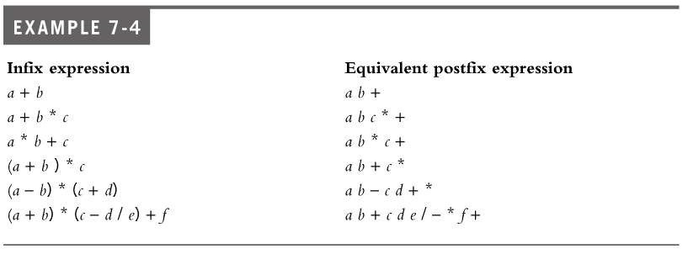
Infix and Postfix Expression Conversion
Data Structures Using C++ 2E

Slide 49
Postfix Algorithm
Postfix expression can be evaluated using the following algorithm
  Scan the expression from left to right
  When an operator is found, back up to get the required number of (preceding) operands, perform the operation
  Repeat until reaching the end of the expression
Data Structures Using C++ 2E

Slide 50
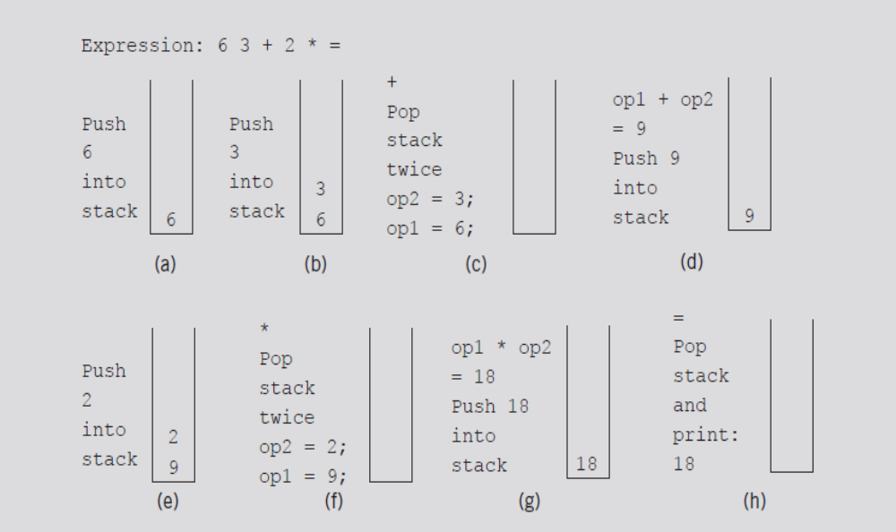
Application of Stacks: Postfix Expressions Calculator (cont’d.)
Postfix expression: 6 3 + 2 * =
FIGURE 7-15 Evaluating the postfix expression: 6 3 + 2 * =
Data Structures Using C++ 2E

Slide 51
Postfix Algorithm w/ Stack
When an operand (number) is encountered in an expression, it is pushed onto the stack.
When we read a symbol other than a number, the following cases arise
  The symbol we read is one of +, -, *, /, or =.
    If the symbol is +, -, *, or /, it is an operator and we must evaluate it. Because an operator requires two operands, the stack must have at least two elements; otherwise, the expression has an error
    If the symbol is =, the expression ends and we must print the answer. The stack must contain exactly one element, which is the result; otherwise, it has an error.
  The symbol we read is something other than +, -, *, /, or =. In this case, the expression contains an illegal operator.
Data Structures Using C++ 2E

Slide 52
Postfix Expression
Consider the following expressions
  7 6 + 3 ; 6 - =
  14 + 2 3 * =
  13 2 3 + =
To make the input easier to read, we assume the postfix expressions are in the following form:
  #6 #3 + #2 * =
The symbol # precedes each number in the expression
Invalid operator ;
Insufficient operand for +
Too many operands
Data Structures Using C++ 2E

Slide 53
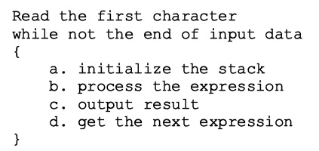
Application of Stacks: Postfix Expressions Calculator (cont’d.)
Main algorithm pseudocode
  Broken into four functions for simplicity
    Function evaluateExpression
    Function evaluateOpr
    Function discardExp
    Function printResult
Data Structures Using C++ 2E

Slide 54
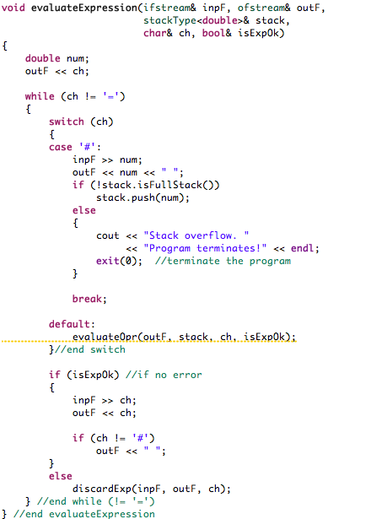
Data Structures Using C++ 2E

Slide 55
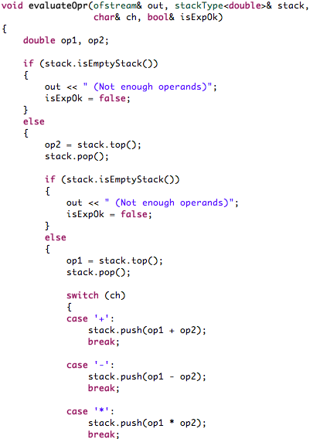
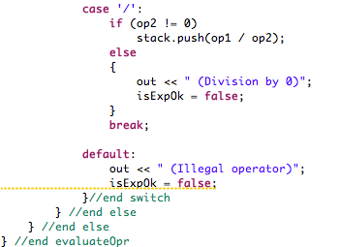
Data Structures Using C++ 2E

Slide 56
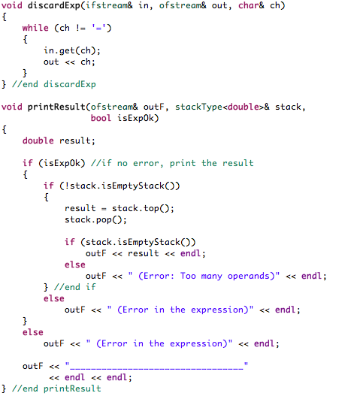
Data Structures Using C++ 2E

Slide 57
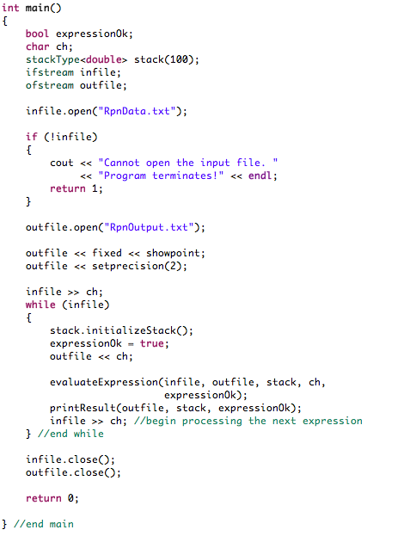
fixed: floating-point values are written using fixed-point notation: the value is represented with exactly as many digits in the decimal part as specified by the precision field (precision) and with no exponent part.
showpoint: the decimal point is always written for floating point values inserted into the stream (even for those whose decimal part is zero).
Data Structures Using C++ 2E

Slide 58
Infix to Postfix Conversion
Initialize an empty stack of operators
While (no error && !end of expression)
  Get next input "token" from infix expression
  If token is …
    "(" : push onto stack
    ")" : pop and append stack elements until
    "(" occurs, do not display it
    operator
    if (stack is empty or operator has higher priority than top of stack)
    push token onto stack
    else
    pop and append top of stack to postfix; repeat comparison of token with top of stack
    Operand: append to postfix
When end of infix reached, pop and append stack items to postfix until empty
Ex: A * B + C
Ex: A * (B + C)
NOTE: ( in stack has lower priority
than operators

Slide 59
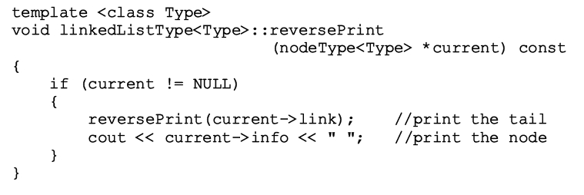
Print a Linked List in Reverse Order (Chapter 6)
Function template to implement previous algorithm and then apply it to a list
Data Structures Using C++ 2E

Slide 60
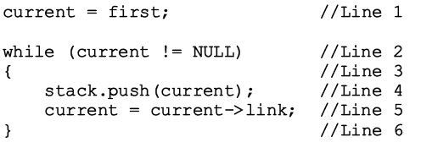
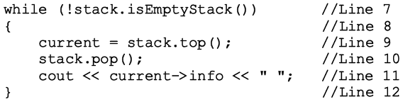
Removing Recursion: Nonrecursive Algorithm to Print a Linked List Backward
Stack
  Used to design nonrecursive algorithm
    Print a linked list backward
Use linked implementation of stack
delete current;
Data Structures Using C++ 2E

Slide 61



FIGURE 7-16 Linked list
FIGURE 7-17 List after the statement current = first; executes
FIGURE 7-18 List and stack after the statements stack.push(current); and current = current->link; execute
Data Structures Using C++ 2E

Slide 62


FIGURE 7-19 List and stack after the 1st while statement executes
FIGURE 7-20 List and stack after the statements current = stack.top(); and stack.pop(); execute
Data Structures Using C++ 2E

Slide 63

STL class stack
Standard Template Library (STL) library class defining a stack
Header file containing class stack definition
  stack
TABLE 7-3 Operations on a stack object
Data Structures Using C++ 2E

Slide 64
Summary
Stack
  Last In First Out (LIFO) data structure
  Implemented as array or linked list
  Arrays: limited number of elements
  Linked lists: allow dynamic element addition
Stack use in compliers
  Translate infix expressions into some form of postfix notation
  Translate postfix expression into machine code
Standard Template Library (STL)
  Provides a class to implement a stack in a program
Data Structures Using C++ 2E

Slide 65
Self Exercises
Programming Exercises: 1, 2, 3, 4, 7, 9
Data Structures Using C++ 2E

